Slide 1
Stock assessment using the software “Stock Synthesis”
NWFSC

Slide 2
Objectives of stock assessment
CATCH
Commercial,
Recreational,
Bycatch (Observers)
ABUNDANCE
NOAA VESSEL and CHARTER SURVEYS,
FISHERY CATCH RATE
BIOLOGY
AGE, GROWTH,
MATURITY
ADVANCED MODELS
HABITAT
CLIMATE
ECOSYSTEM
MANMADE STRESS
POPULATION MODEL
Calculates time series of
Fish Abundance and Mortality
SOCIOECONOMICS
STATUS
Overfishing?
Overfished?
FORECAST
Annual Catch Limit

Slide 3
Types of data
Catches
Guesstimate on depletion
Discards
Effort
Indices of abundance (fishery and/or survey)
Absolute abundance
Catch-at-age with ageing error
Catch-at-length
Age-conditional-on-length
Average length-at-age, average weight-at-length
Average weight, average length
Tagging

Slide 4
Components of population dynamic models
State variables: In the future depend on
Current state
Parameters
Forcing (external shocks)
Rules of change (equations)
Rules of change
Forces
(e.g. catches,
env.)
State variables in
next time period
State variables
(e.g., numbers)
Parameters
(e.g., growth rate)

Slide 5
Fitting to data
The goal is to minimize the difference between observations and model predictions
Minimize the difference
{
Observation
Prediction

Slide 6
Sources of error/uncertainty
Observation error (sampling and measurement error)
Process error (dynamics of the resource and the fishery)
Model error (model’s ability to capture dynamics)
Structure of the error (error distributions in likelihood)
Estimation error (accuracy of the model parameters)
Implementation error (management differs from intended)

Slide 7
Methods
Estimation of parameters
Moments
Least squares
Maximum Likelihood (MLE)
Bayesian (MCMC)
Estimation of uncertainty
Delta method
Bootstrap
Asymptotic theoretical variance (MLE)
Likelihood profile (MLE)
Posterior distribution (Bayesian)

Slide 8
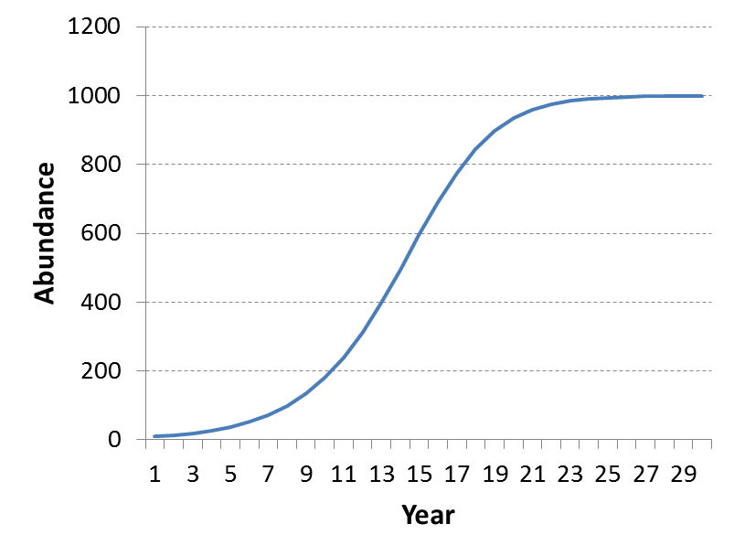
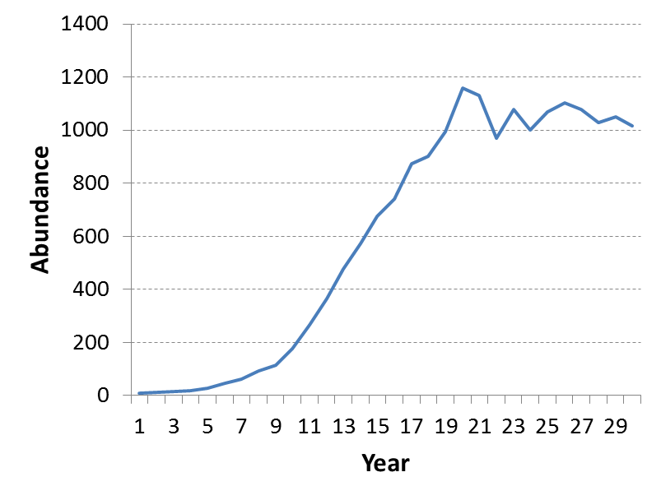
Deterministic or stochastic process error
Should there be random process error?
Deterministic model (no process error)
Stochastic model (with process error)
where w_{t} is a random variable
(typically a normal distribution)

Slide 9
Observation error
From sampling and measurement error
Individual observation error for each piece of data

Slide 10
Process error
Natural variation (time-specific variation)
Recruitment variability
Natural mortality
Selectivity
Growth

Slide 11
Model error
All models are simplifications
We may not fully understand the dynamics of the system
There may be important differences between the model and reality
It is usually not considered in the stock assessment
Absorbed into the process and observation error.

Slide 12
Implementation error
Implications due to failure to implement the agreed upon management actions
Important in decision analysis and projections
Often account for this in Management Strategy Evaluation (MSE)

Slide 13
Model the error
Models can assume known observation and/or process error
Observation error models
regression
Process error models
assume no or known observation error
Models with both errors
State-space models
Integrated analysis models like SS

Slide 14
VPA vs. SCAA
VPA vs SCAA
Calibrated VPA
Estimates abundance of the oldest age and current cohorts
Calculates abundance back in time
Assumes negligible error in the catch at age
F-at-age mostly unconstrained
SCAA
Estimates initial abundance at age, recruitments, fishing mortality, selectivity
Calculates abundance forward in time
Allows error in the catch at age

Slide 15
Integrated Analysis
Long time series of quality catch-at-age and index data are often not available. In response we may:
Truncate time series to shorter period; losing contrast
Create catch-at-age from inadequate data sources; losing sense of imprecision
Switch to biomass dynamics model with simple parameters linked to population r & K
Integrated analysis can:
Span data-poor historical periods and current data-rich era
Compare its expected values to a wide variety of data types
Link to population dynamics through spawner-recruitment

Slide 16
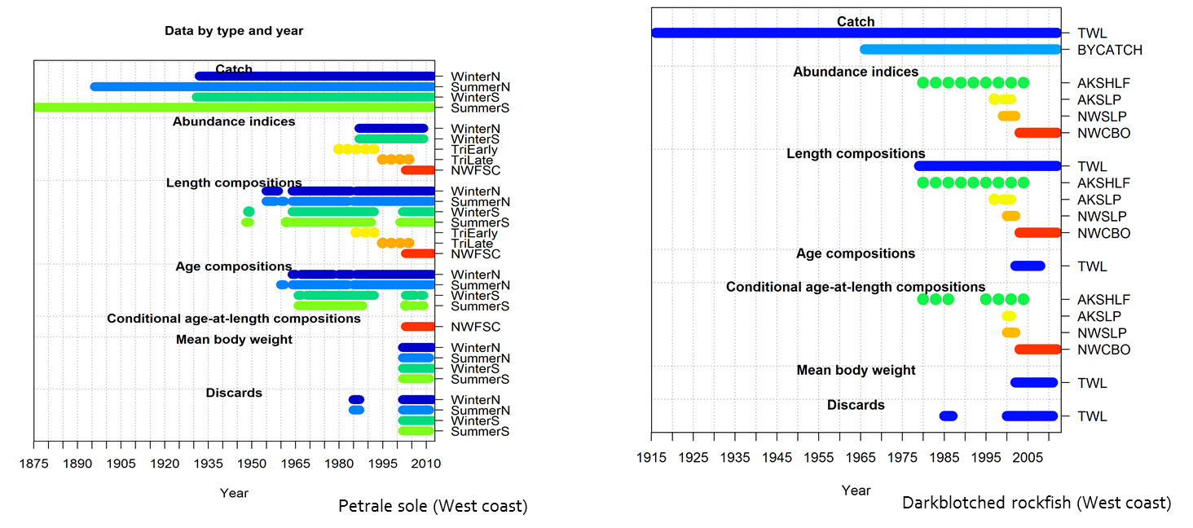
Why Integrated Analysis?
Data available only for some years

Slide 17
IA – SCAA Comparison
SCAA is built around the use of fishery catch-at-age
IA is broader and more flexible concept
Biological characteristics of catch can be represented by size composition, weight composition, or data-free (biomass dynamics model)
Multiple fleets routinely included
Predators can be additional sources of mortality
Alternative information sources (tag-recapture)
Spatial dynamics and movement
Less empirical input (such as body wt-at-age)
More modeling of processes (growth, size-selectivity, ageing imprecision)

Slide 18
History of Integrated Analysis
Fournier & Archibald (1982) provided explicit consideration of errors and use of auxiliary information.
CAGEAN (Deriso et al 1985) - 10s of parameters
Stock Synthesis (Methot, 1989) -10s to 100s of parameters; FORTRAN & numerical derivatives
AD Model Builder (late 1980s) - Computer software to build your own IA, 10s to 1000s of parameters. www.admb-project.org
MULTIFAN-CL (1998) - 1000s of parameters (age and size, tag recapture, movement)
ASAP (Legault& Restrepo, 1998). A flexible forward age-structured assessment program.
Coleraine (Hilborn, Maunder et al, 2000) – comparable to ASAP
CASAL (Bull et. al 2004; New Zealand) C++ algorithmic stock assessment laboratory); age and size structured, tag recapture, movement
GADGET (Begley & Howell, 2004) Globally applicable Area-Disaggregated General Ecosystem Toolbox
Stock Synthesis (Methot, 2005; Methot and Wetzel 2013) – ADMB-based; size & age based model with spatial structure, gender and growth-morphs

Slide 19
Bring model to the data
Don’t transform data to meet rigid model structure
Do add processes to model to develop expected values for diverse, lightly processed data
Improves understanding of processes
Allows simultaneous use of more types of data
Statistical properties of data are preserved and transferred to variance of final model results

Slide 20
Estimation, Benchmarks, Forecasts
Sometimes we use a sequence of separate analyses:
Estimate population abundance time series
Calculate benchmark quantities: target and limit F rates, sometimes based on first fitting spawner-recruitment curve.
Forecast future abundance and catch using the target F
Integrated Analysis can:
Bring all steps into one analytical package
Parameter variance from population estimation gets propagated to quantities in forecast
Example output: probability that stock abundance will dip below the overfished threshold 5 years into the future, and the standard error of this probability

Slide 21
Integrated analysis sub-models
Population Model
Recruitment, mortality, growth
Age and/or size structured
Observation Model
Derive expected values for data
Likelihood-based Statistical Model
Quantify goodness-of-fit
Algorithm to search for parameter set that maximizes likelihood
Auto-Differentiation Model Builder (ADMB)
Cast results in terms of management quantities
Propagate uncertainty for derived and management quantities

Slide 22
IA: No magic bullet
Allows many kinds of data, but data does not assure contrast
Allows many processes to be investigated, but cannot magically remove confounding
Fixing parameter values for some processes (M) will tighten confidence intervals by excluding some alternative explanations for the data
Result probably will have more variance than result from a simpler model – that’s good
A fishery interacting with its ecosystem is complex process; our models should not overly simplify this process just because the data are lacking

Slide 23
From data to results
Result is a complex function of fit to all included data;
Type, contrast and precision of data determine its influence
Examine residuals and root mean squared error of fit to data
Parsimoniously, add enough process to remove pattern to residuals
Judicious re-weighting of inputs to match rmse of output

Slide 24
Data, penalties, priors
Penalties and Priors are information about parameters in a model
Example: maximum age used to create prior on M
Data are information about a derived quantity
Expected value for this quantity is derived from model parameters and structure
Example: Age composition of catch from a fleet
In IA, the expected value for maximum observed age could be derived as a function of M, then observed maximum age could be included as model data
Concept of Data and Priors blur; it’s all information

Slide 25
Relation to Bayesian analysis
Bayesian Analysis (BA) requires prior pdf for all parameters and integrates across this pdf and the posterior pdf to create a posterior pdf of results
Information (meta-data) typically used to create priors for a Bayesian analysis can be included as likelihood penalties in IA for some, but not necessarily all, parameters
Maximum likelihood (MLE) result is like mode of BA
MCMC with IA’s parameter penalties produces pdf like that of BA
The normal pdf based on the uncertainty of the MLE is comparable to the BA pdf from MCMC, at least in many applications.
What about when the distribution is lognormal?

Slide 26
Stock Synthesis
An implementation of IA
Age and size structured, with geographic areas
High diversity of data types, including tags
Fully integrates population estimation, benchmark calculation, and forecasting

